Slide 1
Lab Notebook
Email:___________________________________
Phone Number:__________________________
Address:________________________________
_________________________________________
_________________________________________

Slide 2
Note: Lab reports should be written using 1-inch margins and 12 pt., Times New Roman font.
First and Last Name | Student ID
Month/Day/Year
Course | Section
Instructor’s Name
Lab Report Title
PURPOSE
This section pertains to the main question that you are aiming to answer. This should be stated in the form of a question. (Ex: Which ball will bounce higher: rubber or plastic?)
INTRODUCTION
Provide background information about the experiment as well as any research you have done on this topic. This section should be two paragraphs in length, minimum.
HYPOTHESIS
The hypothesis should be a single statement explaining exactly what you are trying to prove. Use the following format: If… then… because…
MATERIALS
In paragraph form, name all of the materials and equipment used in the experiment. Be sure to include specific measurements, amounts, and concentrations of chemicals used.
METHODS
This section includes step-by-step instructions, in order, explaining the procedures used to complete the experiment. These instructions should be thorough so that someone with less expertise could replicate.
RESULTS
All data must be collected and organized in logical order. Results should be illustrated in charts, tables, graphs, and/or diagrams. All data must include a title. Graphs must include a independent variable (x-axis) and dependent variable (y-axis) label with units.
DISCUSSION & CONCLUSION
The discussion is the most important part of the lab report. This is where you show that you understand the experiment beyond completion. Give detailed accounts of what happened in each step of the experiment and elaborate thoroughly on your results and observations. Analyze and interpret why these results were obtained. Explain the significance of these results. Restate your original hypothesis and explain whether or not the experiment succeeded. If the hypothesis was incorrect, why? Explain any errors in your results and provide an Error Analysis explaining any important factors that may have affected your results.
REFERENCES
List your references such as your teacher’s notes, websites utilized, textbooks, etc.

Slide 3
Table of Contents
No. | Subject/Notes | No. | Subject/Notes
Common Unit Conversions
Length | Mass (Weight)
1 inch = 2.540 centimeters 1 millimeter = 0.03937 inches 1 foot = 30.4878 centimeters 1 centimeters = 0.3937 inches 1 yard = 0.9144028 meters 1 meter = 3.281 feet 1 mile = 1.6093419 kilometer 1 kilometer = 0.621372 miles | 1 grain = 0.00208 ounces 1 ounce = 28.3495 grams 1 gram = 0.03527396 ounces 1 pound = 16 oz = 0.4535924 kilograms 1 kilogram = 2.2046223 pounds 1 short ton = 0.892857 metric ton 1 metric ton = 1.1200 short tons 1 long ton = 1.01605 metric tons
Volume | Area
1 teaspoon = 5 milliliters 1 milliliter = 0.0338147 fluid ounces 1 tablespoon = 15 milliliters 1 liter = 2.11342 pints = 1000 cubic centimeters 1 fluid ounce = 30 milliliters 1 liter = 1.05671 quarts = 0.264178 gallons 1 gallon = 3.785332 liters = 231 cubic inches 1 cup = 0.23658 liters 1 pint = 0.473167 liters 1 cubic meter = 35.3144 cubic feet = 1.30794 cubic yards 1 cubic foot = 0.0283170 cubic meters 1 cubic yard = 0.764559 cubic meters | 1 sq. inch = 6.4516 sq. centimeters 1 sq. centimeter = 0.1550 sq. inches 1 sq. foot = 0.0929 sq. meters 1 sq. meter = 1.195986 sq. yards 1 sq. yard = 0.83613 sq. meters 1 sq. kilometer = 0.386101 sq. miles 1 sq. mile = 2.589999 sq. kilometers 1 hectare = 2.471044 acres 1 acre = 0.404687 hectares
 | Temperature
 | Fahrenheit: Subtract 32, then multiply by 5/9ths Celsius Celsius: Multiply by 9/5ths, then add 32 Fahrenheit

Slide 4
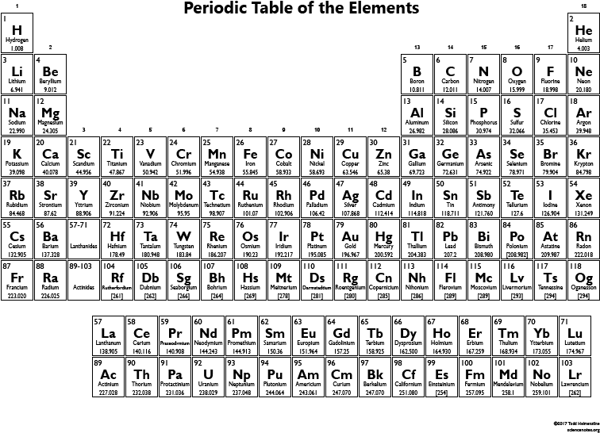
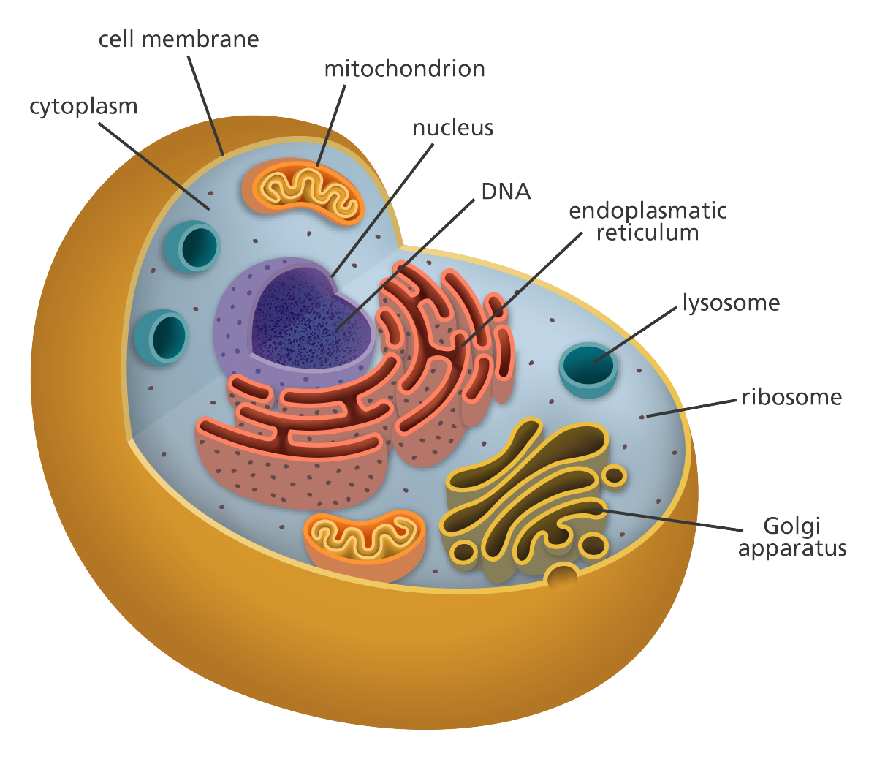
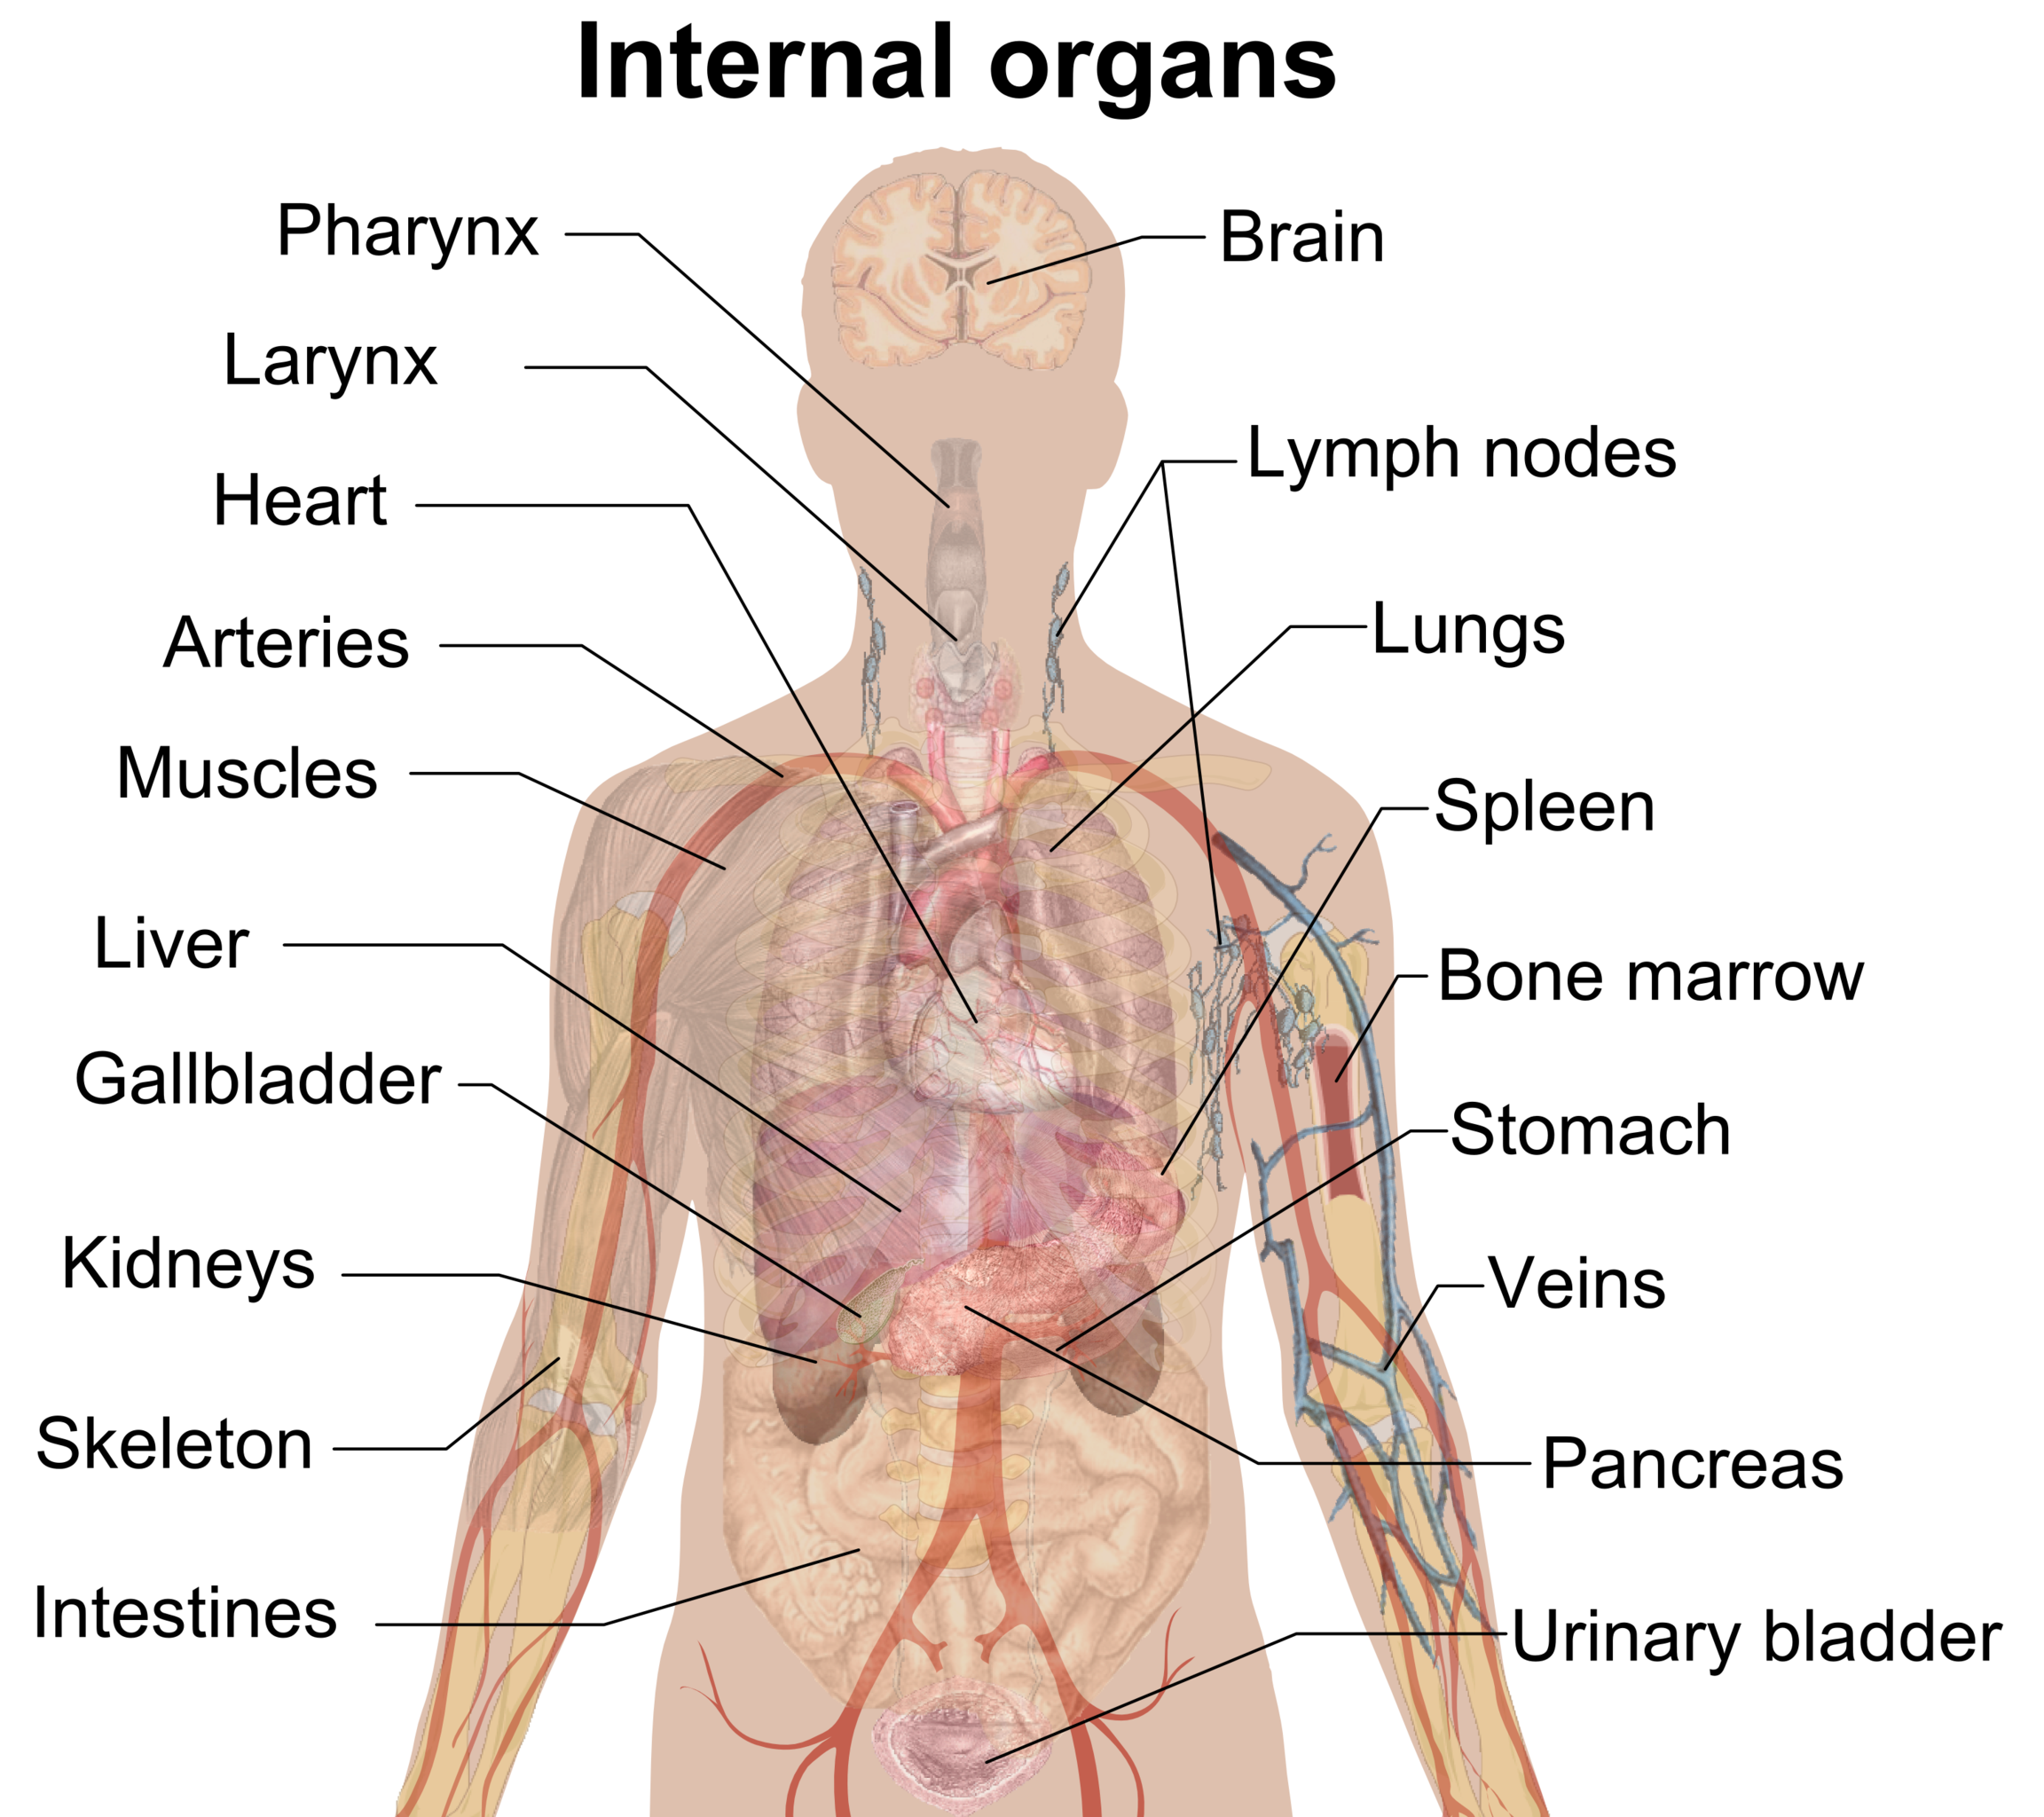
Periodic Table of Elements
Anatomy

Slide 5
No.___ Title:__________________
Name:_____________________________________ Date:___________
Partner(s):___________________________________________________
Purpose:___________________________________________________________________________________________________________________
Hypothesis:__________________________________________________________________________________________________________________________________________________________________________________________________________________________________________________________________________________________________________
Materials:___________________________________________________________________________________________________________________________________________________________________________________________________________________________________________________________________________________________________________
Notes:

Slide 6
Graph Title:______________________________________________

Slide 7
Table Title:______________________________________________
Diagram Title:___________________________________________

Slide 8
Report Draft Title:
Purpose:
Introduction:
Hypothesis:
Materials:
Methods:
Results:
Discussion & Conclusion:

Slide 9
No.___ Title:__________________
Name:_____________________________________ Date:___________
Partner(s):___________________________________________________
Purpose:___________________________________________________________________________________________________________________
Hypothesis:__________________________________________________________________________________________________________________________________________________________________________________________________________________________________________________________________________________________________________
Materials:___________________________________________________________________________________________________________________________________________________________________________________________________________________________________________________________________________________________________________
Notes:

Slide 10
Graph Title:______________________________________________

Slide 11
Table Title:______________________________________________
Diagram Title:___________________________________________

Slide 12
Report Draft Title:
Purpose:
Introduction:
Hypothesis:
Materials:
Methods:
Results:
Discussion & Conclusion:

Slide 13
No.___ Title:__________________
Name:_____________________________________ Date:___________
Partner(s):___________________________________________________
Purpose:___________________________________________________________________________________________________________________
Hypothesis:__________________________________________________________________________________________________________________________________________________________________________________________________________________________________________________________________________________________________________
Materials:___________________________________________________________________________________________________________________________________________________________________________________________________________________________________________________________________________________________________________
Notes:

Slide 14
Graph Title:______________________________________________

Slide 15
Table Title:______________________________________________
Diagram Title:___________________________________________

Slide 16
Report Draft Title:
Purpose:
Introduction:
Hypothesis:
Materials:
Methods:
Results:
Discussion & Conclusion:

Slide 17
No.___ Title:__________________
Name:_____________________________________ Date:___________
Partner(s):___________________________________________________
Purpose:___________________________________________________________________________________________________________________
Hypothesis:__________________________________________________________________________________________________________________________________________________________________________________________________________________________________________________________________________________________________________
Materials:___________________________________________________________________________________________________________________________________________________________________________________________________________________________________________________________________________________________________________
Notes:

Slide 18
Graph Title:______________________________________________

Slide 19
Table Title:______________________________________________
Diagram Title:___________________________________________

Slide 20
Report Draft Title:
Purpose:
Introduction:
Hypothesis:
Materials:
Methods:
Results:
Discussion & Conclusion:

Slide 21
No.___ Title:__________________
Name:_____________________________________ Date:___________
Partner(s):___________________________________________________
Purpose:___________________________________________________________________________________________________________________
Hypothesis:__________________________________________________________________________________________________________________________________________________________________________________________________________________________________________________________________________________________________________
Materials:___________________________________________________________________________________________________________________________________________________________________________________________________________________________________________________________________________________________________________
Notes:

Slide 22
Graph Title:______________________________________________

Slide 23
Table Title:______________________________________________
Diagram Title:___________________________________________

Slide 24
Report Draft Title:
Purpose:
Introduction:
Hypothesis:
Materials:
Methods:
Results:
Discussion & Conclusion:

Slide 25
No.___ Title:__________________
Name:_____________________________________ Date:___________
Partner(s):___________________________________________________
Purpose:___________________________________________________________________________________________________________________
Hypothesis:__________________________________________________________________________________________________________________________________________________________________________________________________________________________________________________________________________________________________________
Materials:___________________________________________________________________________________________________________________________________________________________________________________________________________________________________________________________________________________________________________
Notes:

Slide 26
Graph Title:______________________________________________

Slide 27
Table Title:______________________________________________
Diagram Title:___________________________________________

Slide 28
Report Draft Title:
Purpose:
Introduction:
Hypothesis:
Materials:
Methods:
Results:
Discussion & Conclusion:

Slide 29
No.___ Title:__________________
Name:_____________________________________ Date:___________
Partner(s):___________________________________________________
Purpose:___________________________________________________________________________________________________________________
Hypothesis:__________________________________________________________________________________________________________________________________________________________________________________________________________________________________________________________________________________________________________
Materials:___________________________________________________________________________________________________________________________________________________________________________________________________________________________________________________________________________________________________________
Notes:

Slide 30
Graph Title:______________________________________________

Slide 31
Table Title:______________________________________________
Diagram Title:___________________________________________

Slide 32
Report Draft Title:
Purpose:
Introduction:
Hypothesis:
Materials:
Methods:
Results:
Discussion & Conclusion:

Slide 33
No.___ Title:__________________
Name:_____________________________________ Date:___________
Partner(s):___________________________________________________
Purpose:___________________________________________________________________________________________________________________
Hypothesis:__________________________________________________________________________________________________________________________________________________________________________________________________________________________________________________________________________________________________________
Materials:___________________________________________________________________________________________________________________________________________________________________________________________________________________________________________________________________________________________________________
Notes:

Slide 34
Graph Title:______________________________________________

Slide 35
Table Title:______________________________________________
Diagram Title:___________________________________________

Slide 36
Report Draft Title:
Purpose:
Introduction:
Hypothesis:
Materials:
Methods:
Results:
Discussion & Conclusion:

Slide 37
No.___ Title:__________________
Name:_____________________________________ Date:___________
Partner(s):___________________________________________________
Purpose:___________________________________________________________________________________________________________________
Hypothesis:__________________________________________________________________________________________________________________________________________________________________________________________________________________________________________________________________________________________________________
Materials:___________________________________________________________________________________________________________________________________________________________________________________________________________________________________________________________________________________________________________
Notes:

Slide 38
Graph Title:______________________________________________

Slide 39
Table Title:______________________________________________
Diagram Title:___________________________________________

Slide 40
Report Draft Title:
Purpose:
Introduction:
Hypothesis:
Materials:
Methods:
Results:
Discussion & Conclusion:

Slide 41
No.___ Title:__________________
Name:_____________________________________ Date:___________
Partner(s):___________________________________________________
Purpose:___________________________________________________________________________________________________________________
Hypothesis:__________________________________________________________________________________________________________________________________________________________________________________________________________________________________________________________________________________________________________
Materials:___________________________________________________________________________________________________________________________________________________________________________________________________________________________________________________________________________________________________________
Notes:

Slide 42
Graph Title:______________________________________________

Slide 43
Table Title:______________________________________________
Diagram Title:___________________________________________

Slide 44
Report Draft Title:
Purpose:
Introduction:
Hypothesis:
Materials:
Methods:
Results:
Discussion & Conclusion:

Slide 45
No.___ Title:__________________
Name:_____________________________________ Date:___________
Partner(s):___________________________________________________
Purpose:___________________________________________________________________________________________________________________
Hypothesis:__________________________________________________________________________________________________________________________________________________________________________________________________________________________________________________________________________________________________________
Materials:___________________________________________________________________________________________________________________________________________________________________________________________________________________________________________________________________________________________________________
Notes:

Slide 46
Graph Title:______________________________________________

Slide 47
Table Title:______________________________________________
Diagram Title:___________________________________________

Slide 48
Report Draft Title:
Purpose:
Introduction:
Hypothesis:
Materials:
Methods:
Results:
Discussion & Conclusion:

Slide 49
No.___ Title:__________________
Name:_____________________________________ Date:___________
Partner(s):___________________________________________________
Purpose:___________________________________________________________________________________________________________________
Hypothesis:__________________________________________________________________________________________________________________________________________________________________________________________________________________________________________________________________________________________________________
Materials:___________________________________________________________________________________________________________________________________________________________________________________________________________________________________________________________________________________________________________
Notes:

Slide 50
Graph Title:______________________________________________

Slide 51
Table Title:______________________________________________
Diagram Title:___________________________________________

Slide 52
Report Draft Title:
Purpose:
Introduction:
Hypothesis:
Materials:
Methods:
Results:
Discussion & Conclusion:

